Slide 1
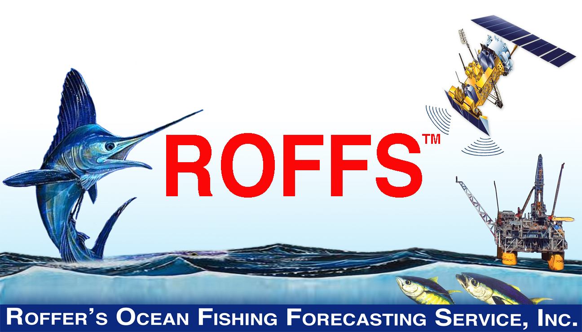

NASA Biodiversity and Ecological Forecasting Science Team Meeting
College Park, MD April 23, 2015
Notes:
Welcome

Slide 2

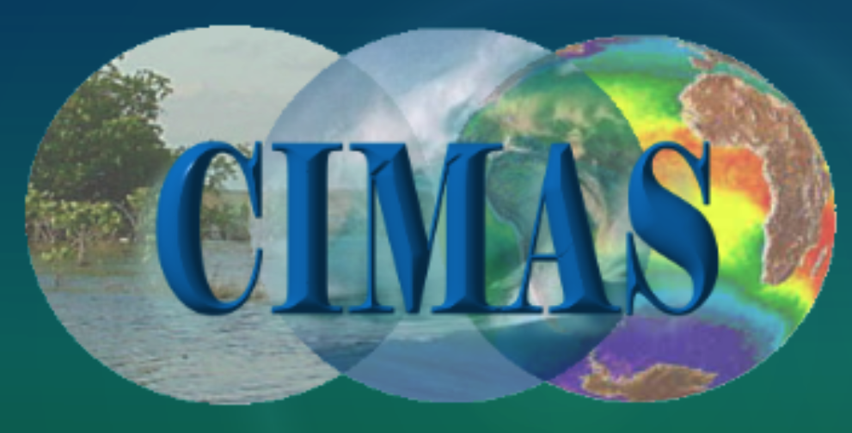

NASA PROJECT HIGHLIGHTS
Management And Conservation Of Atlantic Bluefin Tuna (Thunnus Thynnus) And Other Highly Migratory Fish In The Gulf Of Mexico Under IPCC Climate Change Scenarios: A Study Using Regional Climate And Habitat Models.
  PI: M. A. Roffer – ROFFS™
  Co-I: J.T. Lamkin (NOAA), F.E. Muller-Karger (USF), S-K Lee (UM CIMAS), B.A. Muhling (UM CIMAS), G.J. Goni (NOAA)
  Other Investigator: Y. Liu (UM CIMAS), M.A. Upton, (ROFFS™) & G. Gawlikowski (ROFFS™), G.W. Ingram (NOAA)
  Other collaborators added: W. Nero (NOAA), J. Franks (USM), J. Quattro (USC)
    D. Enfield (NOAA), John F. Walter (NOAA), A. Bakun (UM RSMAS), K. Ramirez (INAPESCA), F. Alemany (IEO), A. Garcia (IEO) . . and growing
  Start date September 06, 2011 – End date September 05, 2015
Multi-sector and multi-disciplinary partnership,
including government fishery scientists and managers
Notes:
Intergovernmental panel on Climate Change

Slide 3
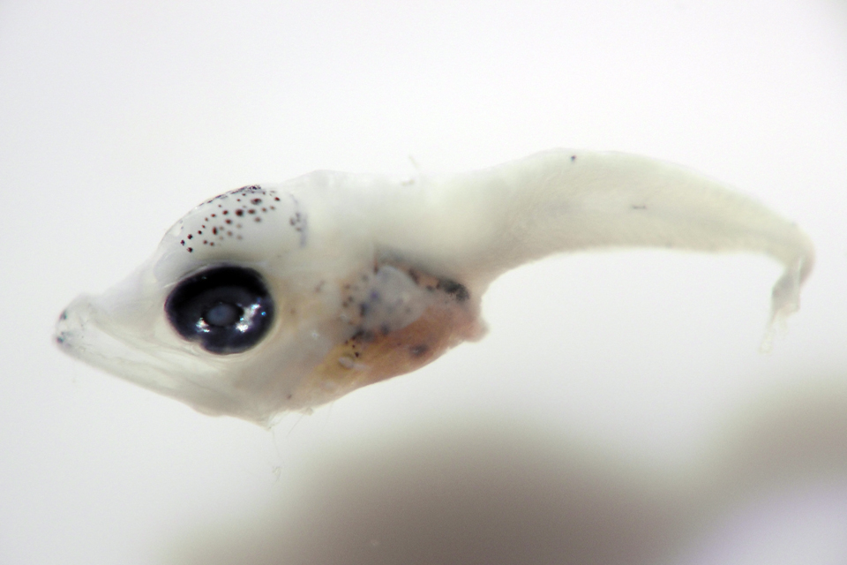
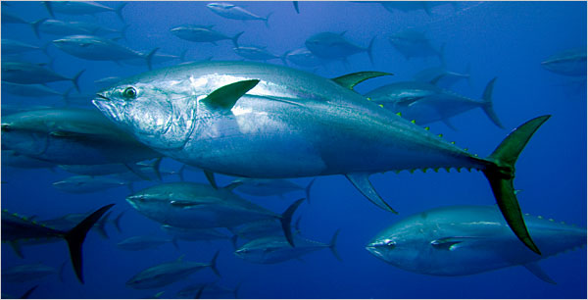
NASA Applications Research
Focuses on enhancing the management of Atlantic bluefin tuna (Thunnus thynnus) and other highly migratory tunas and billfishes in the Gulf of Mexico and surrounding waters considering climate change.
  Using data with differing scales.
    MM’s to M’s to KM’s to 1000’s KM scales
    Hourly to daily to 100 year time scales
  Transition the routine use of satellite data

Slide 4
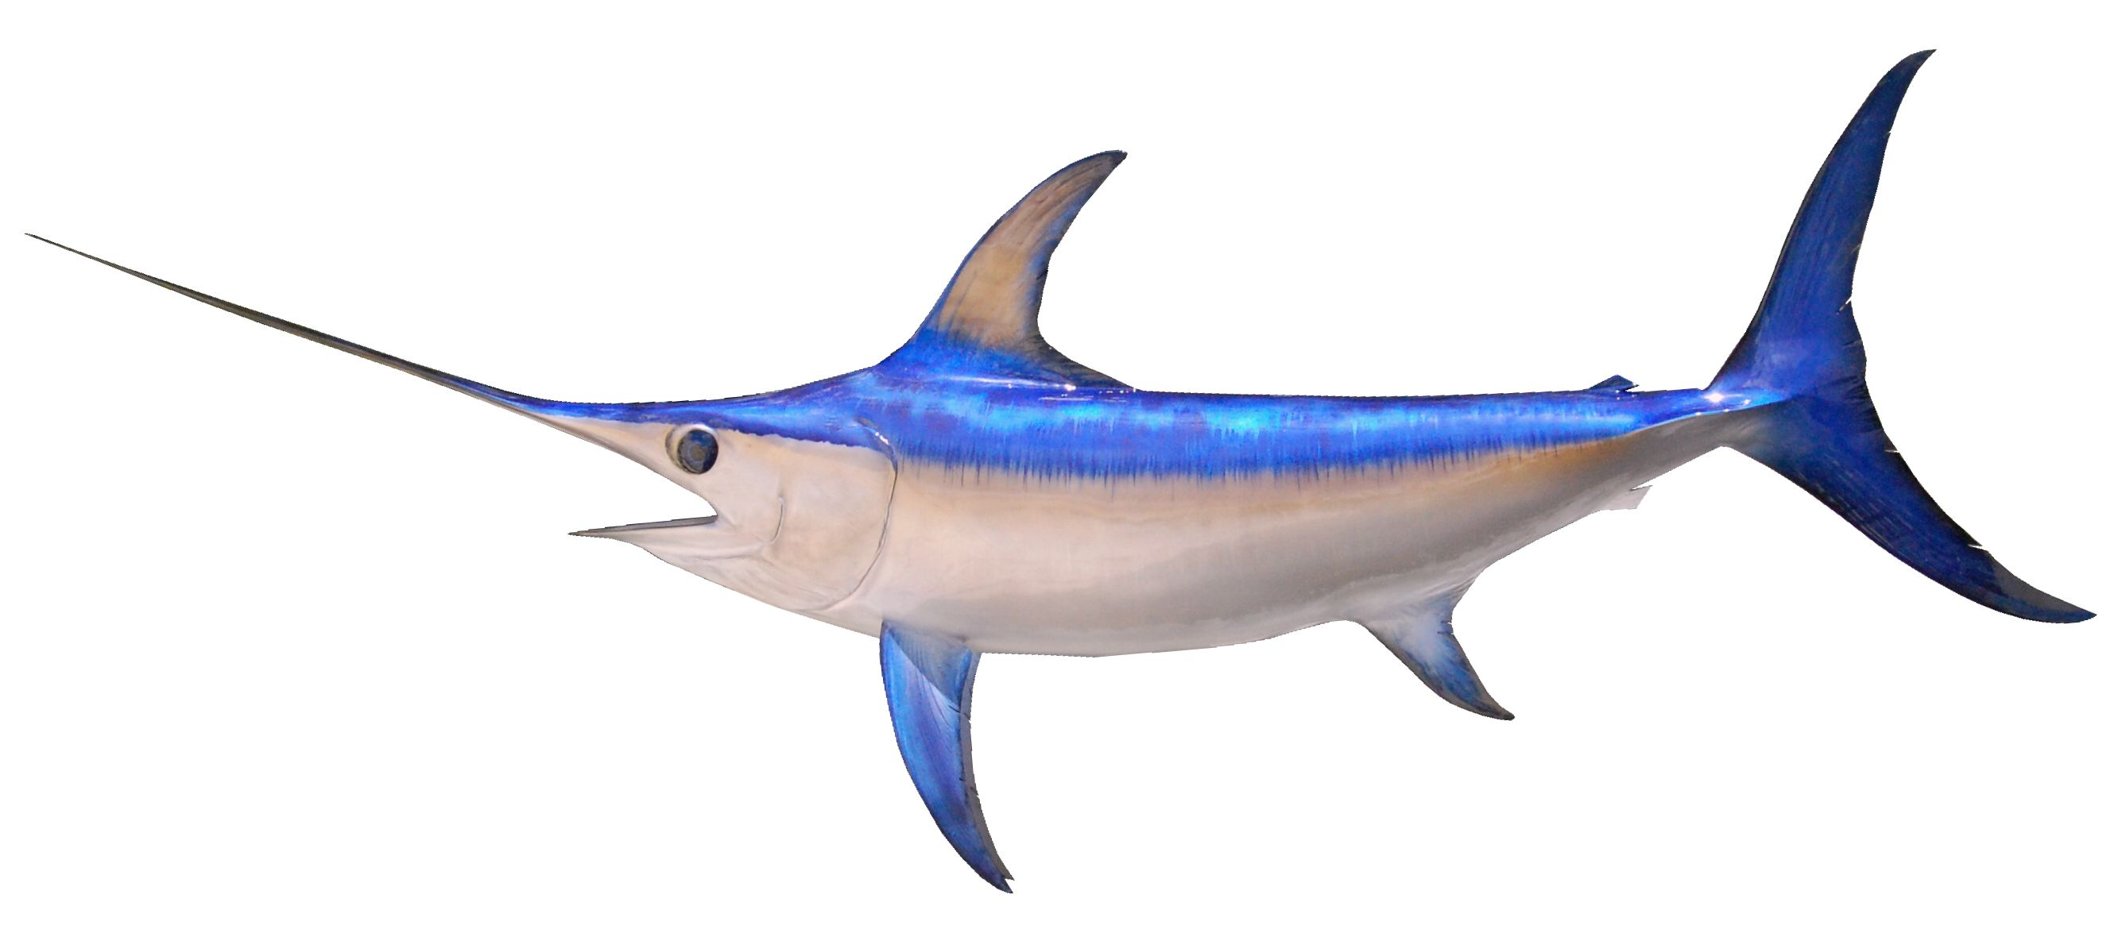
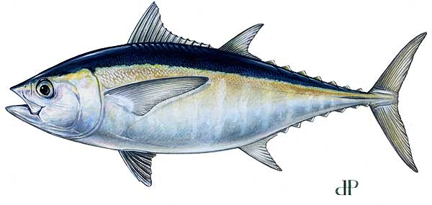
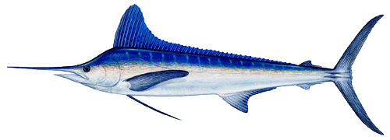
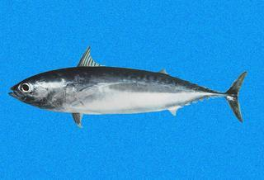
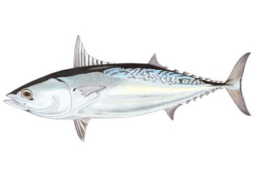
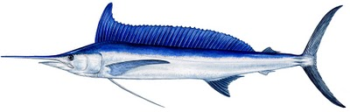
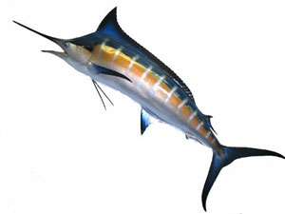


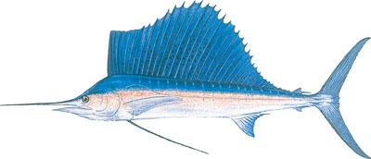
Charismatic Mega Fauna
Atlantic bluefin tuna (Thunnus thynnus)
Atlantic blue marlin (Makaira nigricans),
Atlantic sailfish (Istiophorus platypterus),
Atlantic white marlin (Tetrapturus albidus),
Blackfin tuna (Thunnus atlanticus),
Bullet mackerel (Auxis rochei),
Frigate mackerel (Auxis thazzard),
Longbill spearfish (Tetrapturus pfluegeri),
Swordfish (Xiphias gladius),
Yellowfin tuna (Thunnus albacares)
Skipjack tuna (Katsuwonis pelamis)

Slide 5
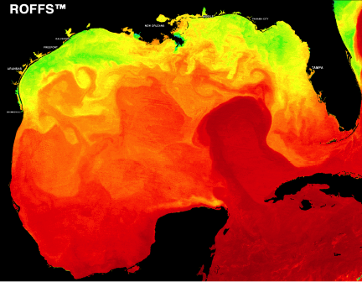
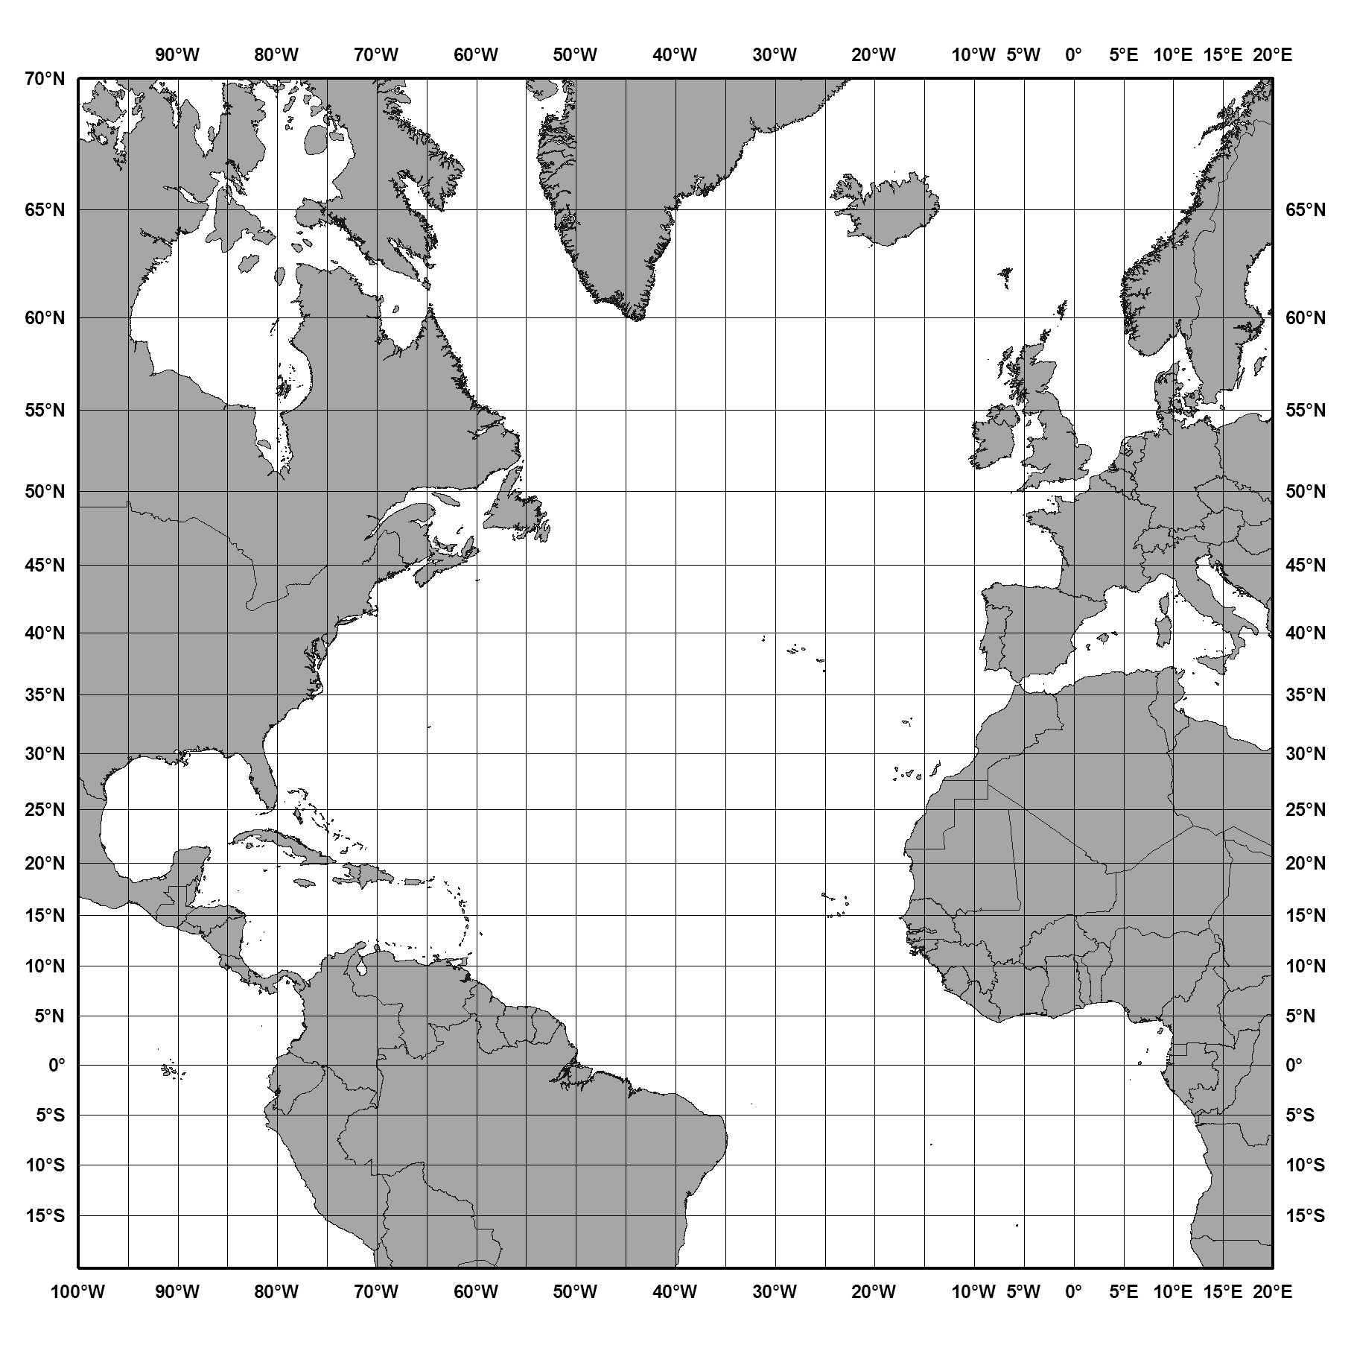
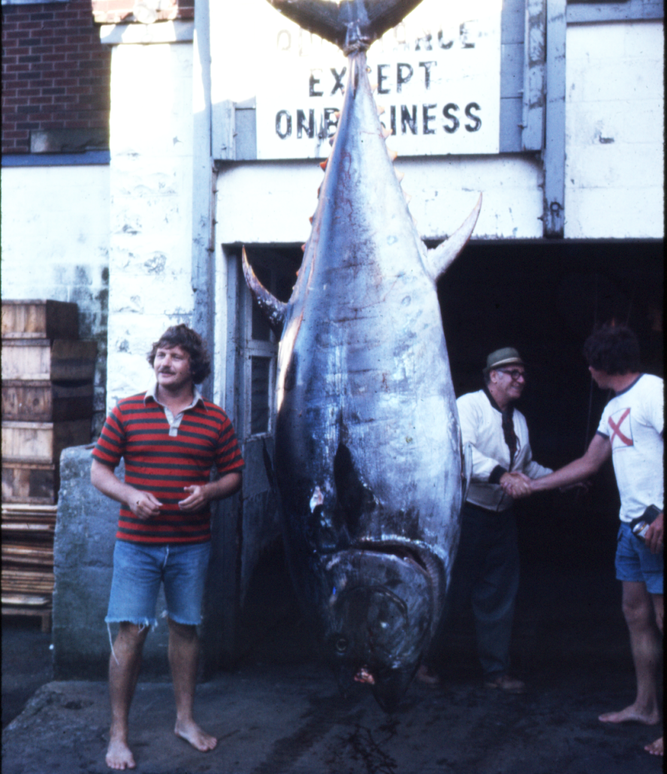
Gulf of Mexico & North Atlantic Ocean
Larvae and Adults
30+ years of larvae cruise
data (larvae, in situ, satellite)
Climate model domain
1000’s km
2 m
6 mm
23 years commercial
longline data
Notes:
Model domain for downscaling

Slide 6
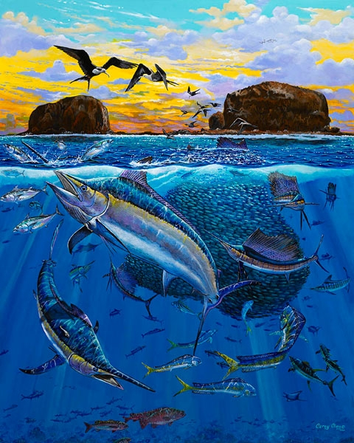
Always Thinking Applications:
Fisheries Managers & Effects of Climate Variation
Changes in lengths of spawning seasons (dates of spawning commencement and end).
Changes in spatial and temporal extent of 3D habitat of adult fish.
Implications for potential effects on recruitment, species – species guilds and sustainability of stocks.
Stock assessments, information, and tools for decisions related to management.
  NOAA’s National Marine Fisheries Service and International Commission for the Conservation of Atlantic Tunas (ICCAT).
    Every thing we do probably has political ramifications

Slide 7
Aspects of Ecological Models Biodiversity
Habitat models
Ocean and atmospheric Circulation models
Climate change

Slide 8
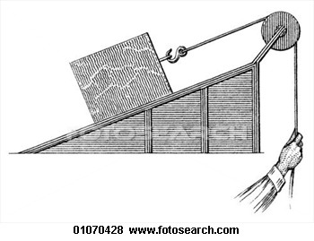
Summary of Methods
Developed habitat models of larvae and adults using boosted classification tree and neural network models
  Multivariate, non-parametric methods
Downscaling climate models for 100 year forecasts
  CMIP5 simulations using MOM4 (GFDL Modular Ocean Model) – Grid: 0.1° in GOM, 0.25° outside
  Now MOM4-TOPAZ biogeochemical model.
    1° x 1° North Atlantic
Satellite IR, ocean color, (NASA-MODIS, NOAA, JPSS-VIIRS), altimetry
  In habitat model development
  Provide strategic and tactical cruise work
  Climatology of GMex & North Atlantic
  Validation of climate models

Slide 9
"Those who don't know history are doomed to repeat it. (Edmund Burke, 1729)
Liu, Y., S.-K., Lee, D.B. Enfield, B.A. Muhling, J.T. Lamkin, F.E. Muller-Karger, and M.A. Roffer. 2015. Impact of global warming on the Intra-Americas Sea: part-1. A dynamic downscaling of the CMIP5 model projections. J. Mar. Syst. 148:56-69.
Muhling, B.A., Y. Liu, S.-K. Lee, J.T. Lamkin, M.A. Roffer, F.E Muller-Karger, and J.F. Walter III. 2015. Potential impact of climate change on the Intra-Americas Sea: Part-2. Implications for Atlantic bluefin tuna and skipjack tuna adult and larval habitats. J. Mar. Syst. 148: 1-13.
Muhling, B.A., P. Reglero, L. Ciannelli, D. Alvarez-Berastegui, F. Alemany, J.T. Lamkin, and M. A. Roffer. 2013. A comparison between environmental characteristics of larval bluefin tuna (Thunnus thynnus) habitat in the Gulf of Mexico and western Mediterranean Sea. Marine Prog. Ser. 486:257-276.
Muhling, B.A., M.A. Roffer, J.T. Lamkin, G.W. Ingram, Jr., M.A. Upton, G. Gawlikowski, F.E. Muller-Karger, S. Habtes, and W.J. Richards. 2012. Overlap between Atlantic bluefin tuna spawning grounds and observed Deepwater Horizon surface oil in the northern Gulf of Mexico. Marine Pollution Bull. 64(4):697-687.
Habtes, S., F.E. Muller-Karger, M. A. Roffer, J.T. Lamkin, and B. A. Muhling. 2014 A comparison of sampling methods for larvae of medium and large epipelagic fish species during SEAMAP ichthyoplankton surveys in the Gulf of Mexico. Limnol. Oceanogr.: Methods 12: 86-101.
Muhling, B.A., J.T. Lamkin, J.M. Quatro, R.H. Smith, M.A. Roberts, M.A. Roffer, and K. Ramirez. 2011. Collection of Larval Bluefin Tuna (Thunnus thynnus) Outside Documented Western Atlantic Spawning Grounds. Bull. Mar. Sci. Bull. Mar. Sci. 87(3):687-694.).
Muhling, B.A., J.T. Lamkin, and M.A. Roffer. 2010. Predicting the Occurrence of Bluefin Tuna (Thunnus thynnus) Larvae in the Northern Gulf of Mexico: Building a Classification Model from Archival Data. Fish. Oceanogr. 19:6, 526-539.
Notes:
Hope you saw our posters

Slide 10
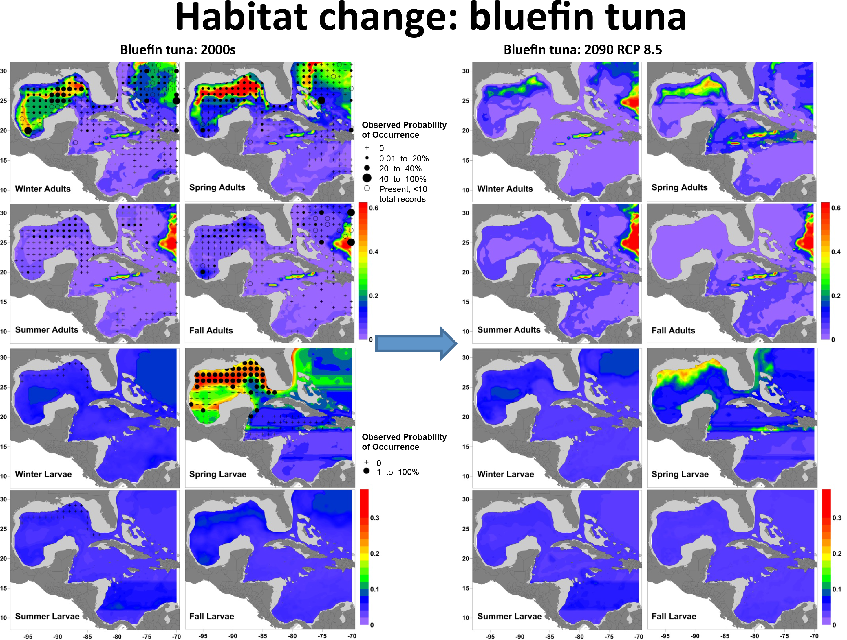
Bluefin Climate Affects

Slide 11
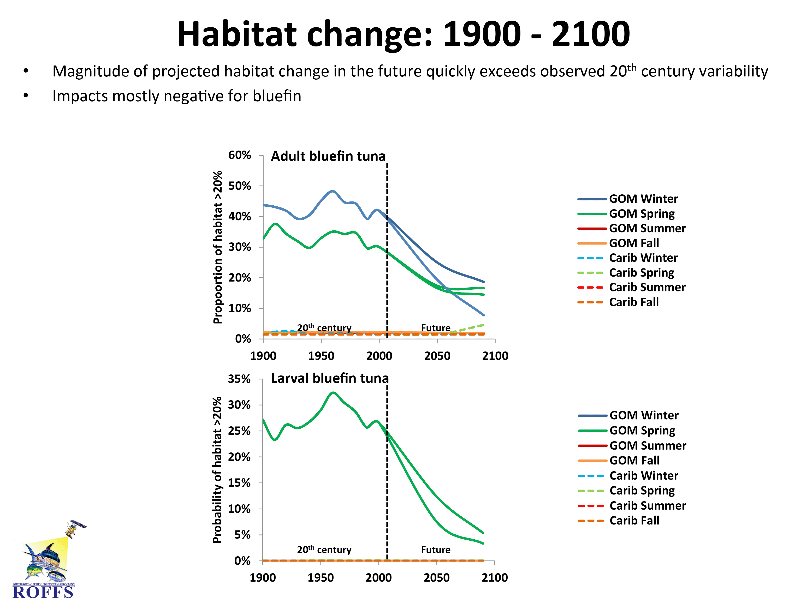

Slide 12
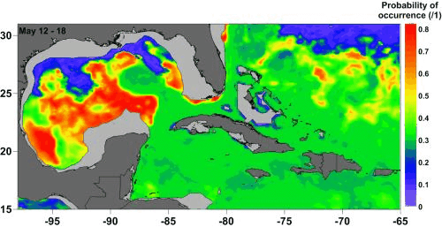
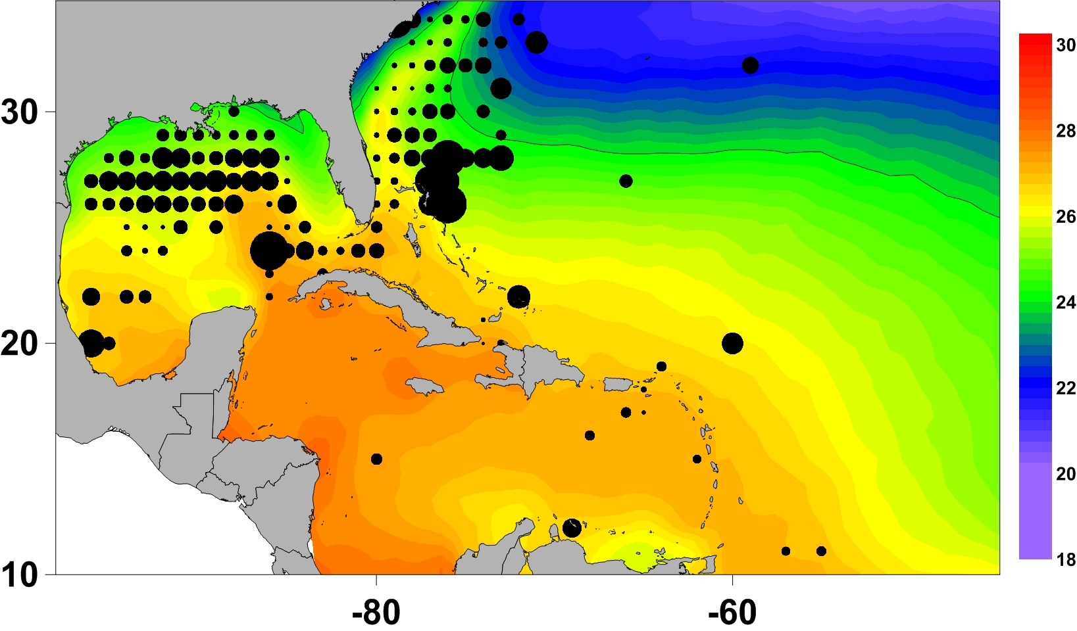
Use of Habitat Models for
Finding Alternative Spawning Areas
Other Than Gulf of Mexico With Satellite Derived Oceanographic Guidance
Adult Catches 1987-2012
ABT larvae habitat model product:
satellites (1-4km) + other ocean data + larvae. Model from May 12-18, 2013

Slide 13
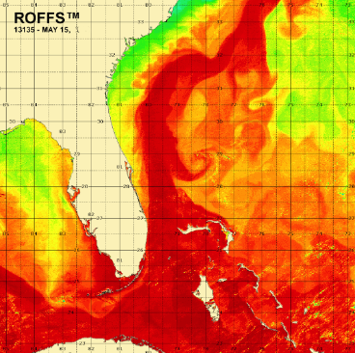
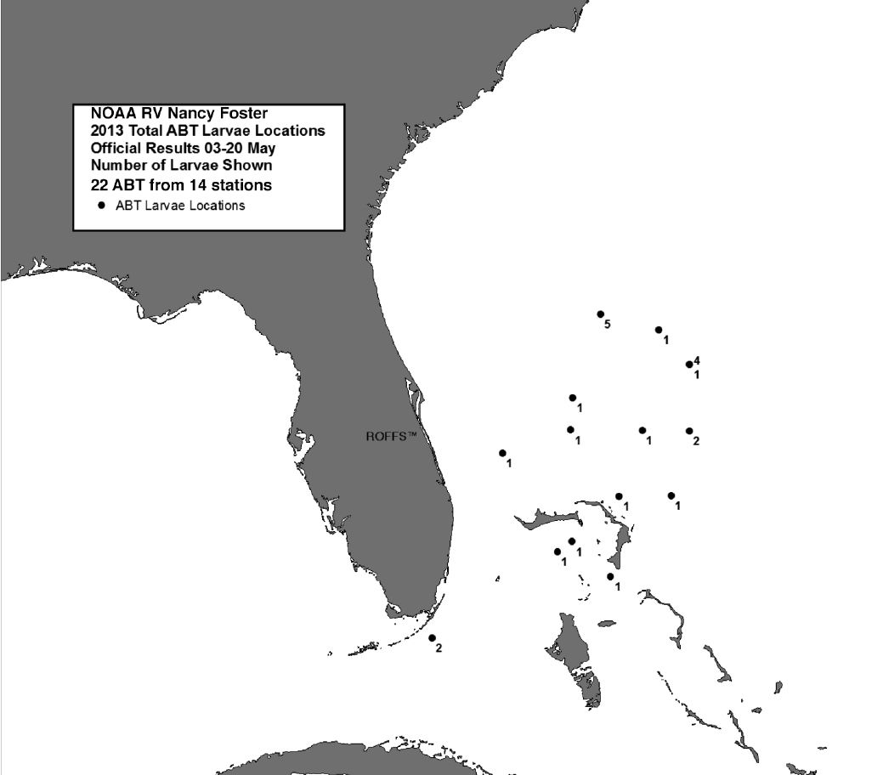
2013 NOAA Research Cruise
IR compsite

Slide 14
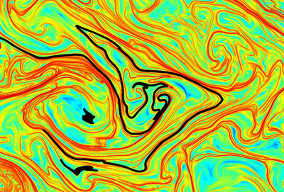
Are Bluefin Spawning Outside the Gulf of Mexico in Bahamas
Assumed all, 22, larvae were between 7-10 days old and we back tracked them for 10 days based on water mass’s Lagrangian Coherent Structures.
19 ABT definitely spawned in Bahamas
1 in the Gulf Stream
2 either the Gulf Stream or Bahamas

Slide 15
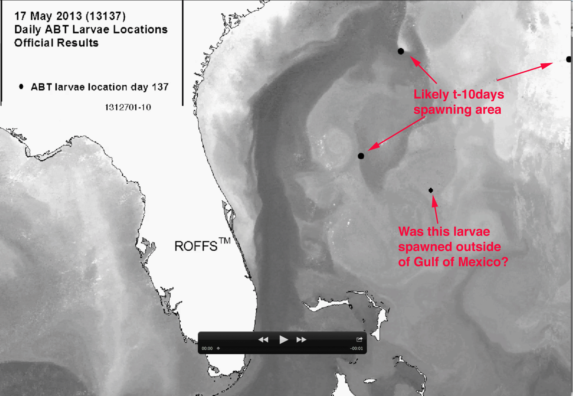
Movie: FL-SC-Bahamas
Daily 00z-10z IR Composites 2013127-137

Slide 16
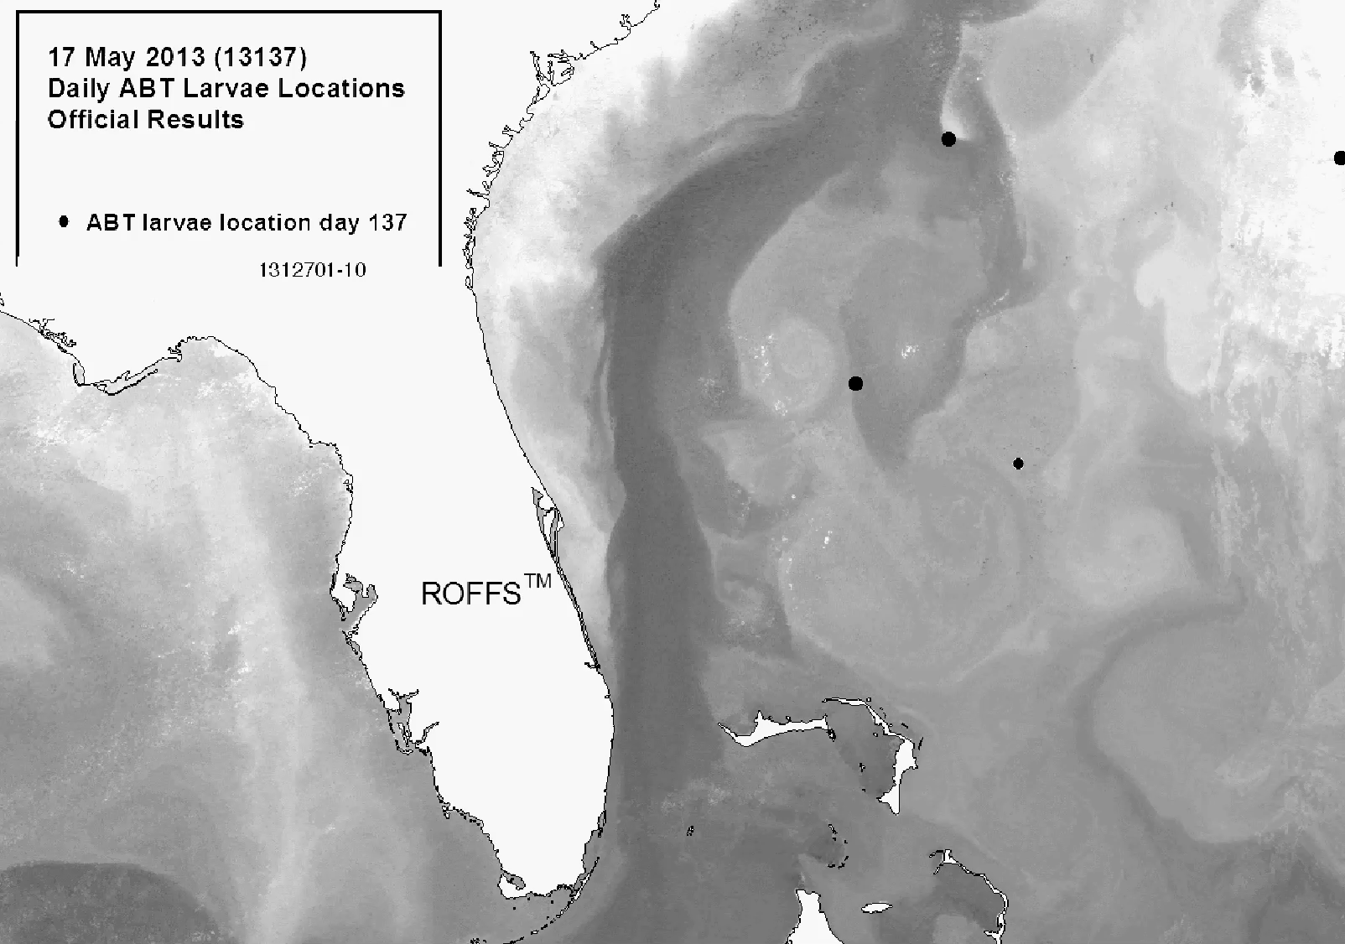

Slide 17

Biodiversity Relevance
How do species survive over millennia when habitats change?
Will the Gulf of Mexico population
become extinct due to reproductive failure?
Will population just move to Bahamas or other new favorable habitat to spawn?
How much of the population will be lost in transition?
  How do you manage this?
  What have we learned from other ecosystems (land or water) about this?

Slide 18
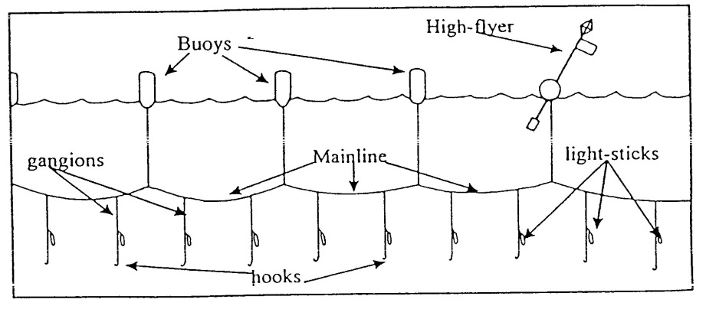
Habitat Modeling: Adults
The most comprehensive source of adult data is from fisheries-dependent longline fishery records
  Logbook program: all US fishing vessels are required to submit catch logbooks detailed catch composition and gear deployed for each longline set. Mandatory since 1992
  Observer program: government observers are placed on fishing vessels, and record more detailed information on size, weight and sex of fish. Program began in 1992, but coverage is very limited
  ICCAT Task 2 database: Reports by countries to ICCAT
Many issues with the data: re: target species, reporting reliability, gear changes, management changes (e.g. quotas, closed areas), not include recreationally caught fish…….., but it is the primary data one uses.

Slide 19
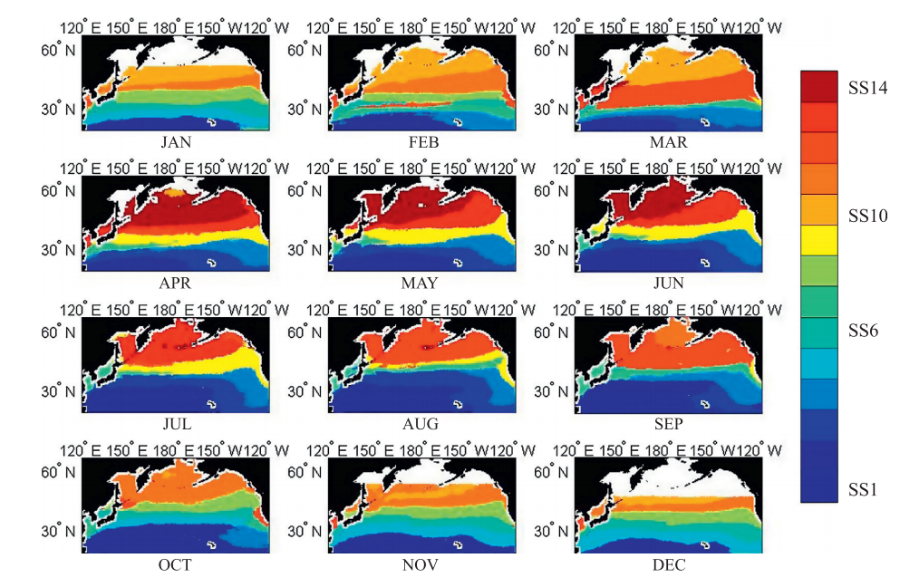
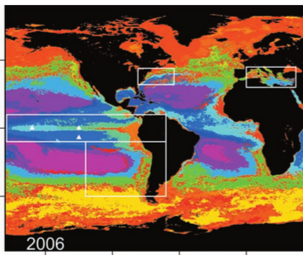
HMS Pelagic Habitat Modeling
North Atlantic Ocean
Mesoscale to basin-scale changes in circulation, productivity and food webs have been shown to exert significant effects on multiple trophic levels
However, exact mechanisms and key variables not always clear
One approach: instead of investigating one or more environmental variables separately, define multivariate habitats and track variability and change
  “Dynamic biomes” (Matthew Oliver & Andrew Irwin, 2008) – NASA Funded
  “Seascapes” (Maria Kavanaugh et al., 2014) – NASA Funded
We aimed to extend these methods to define discrete pelagic habitats in the North Atlantic based on HMS + examine variability on multi-decadal timescales
Pacific seascapes based on satellite-derived SST, chl and PAR
(Kavanaugh et al., 2014)
Global dynamic biomes from satellite-derived ocean color products (Oliver & Irwin, 2008)

Slide 20
Methods: MOM-TOPAZ
Yanyun Liu and Sang-Ki Lee (see poster and paper)
MOM4.1 with TOPAZ biogeochemical model
Temperature and salinity fields initialized from WOA, integrated for 500 years using CORE2 surface flux fields.
After 500 years of spin-up, integrated for 1948-2009 using real-time surface flux fields.
Environmental variables output at 1°x1° resolution by year and season:
  Surface temperature
  Temperature at 100m depth
    Used to calc. temp. difference between surface and 100m
  Current magnitude (m/s)
  Oxygen at 100m depth (mg/L)
  Surface chlorophyll (mg/m³)
We chose variables shown previously to be important to the physiology and habitat preference of our HMS pelagic fishes

Slide 21
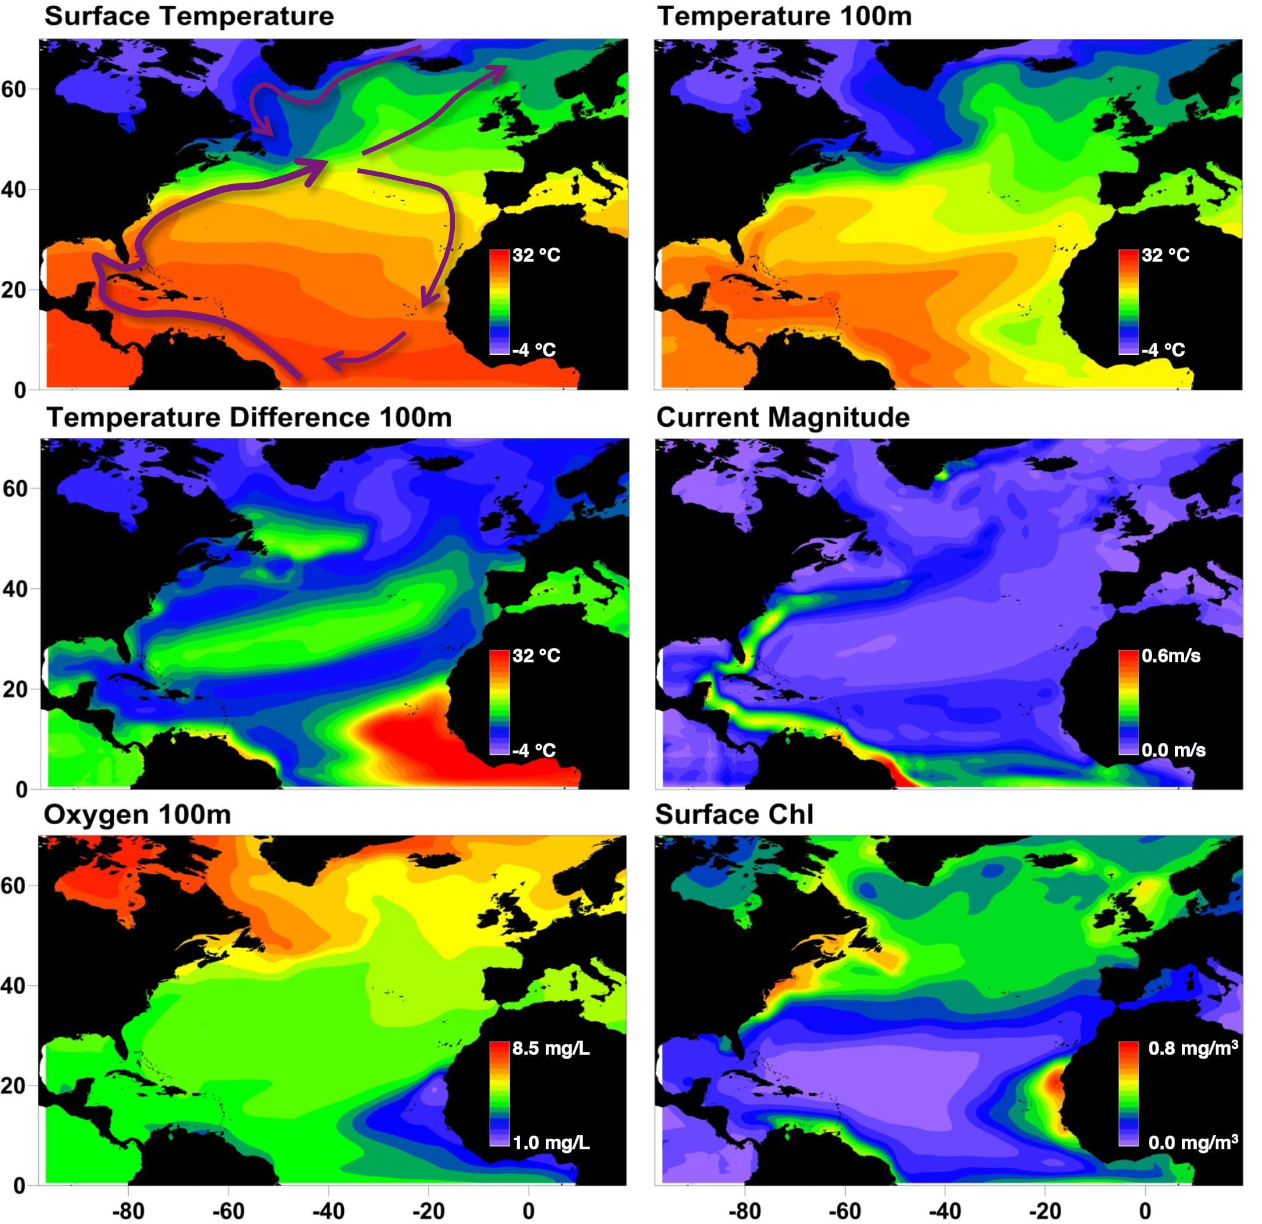
Environmental Variables: 50 year annual means
Temperatures increase with latitude, but not uniformly
Colder at depth more anoxic off Africa: upwelling
Current magnitude shows major currents
Chlorophyll higher off northeast US, north of 40°N, and off west Africa
Schematic of major current systems

Slide 22
Methods: Habitat Definition
Characteristics of each latitude/longitude point in space and time defined in terms of environmental variables.
Ward clustering (Matlab) used to define 15 pelagic habitats in terms of environmental characteristics
Spatial extent (km²) of each habitat calculated by year and season in ArcGIS, as well as mean latitude.
Used ordination techniques (PCO) to highlight habitats which varied synchronously through time, or inversely.
PCO also used to highlight years which were very similar, or different, to each other

Slide 23
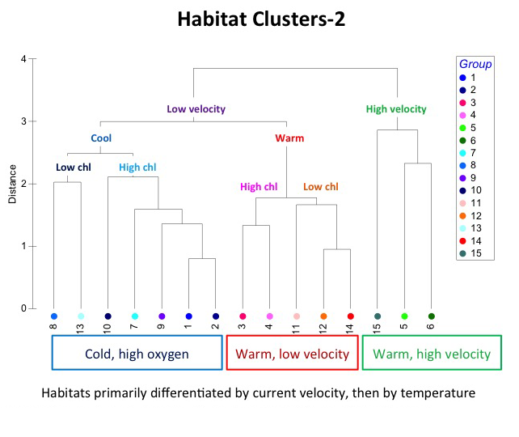
Reminder that this is derived from commercial longline data

Slide 24
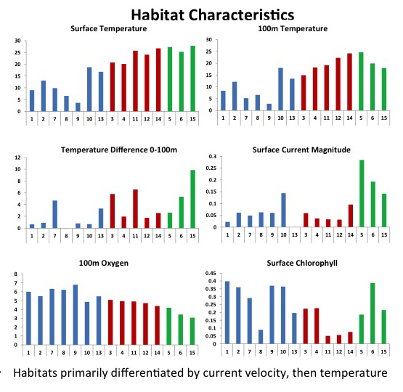

Slide 25
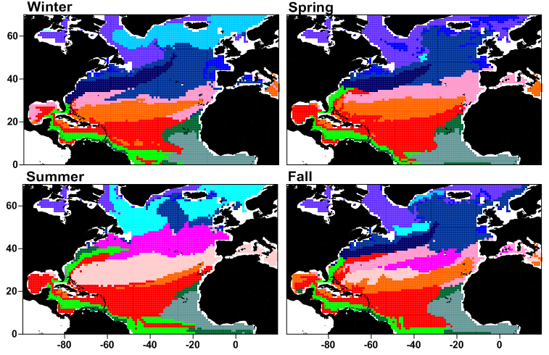
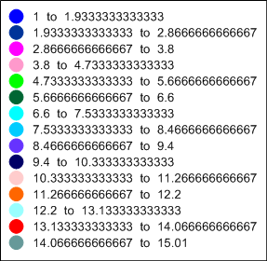
Habitat Clusters
Clusters structured by latitude, but note effects of Gulf Stream, upwelling off Africa
Gulf Stream results in tilt of northern habitats towards NE Atlantic
Habitats often move poleward during summer, or are replaced by others
Cluster
1
2
3
4
5
6
7
8
9
10
11
12
13
14
15
Notes:
(Future work: validate these with 2000s climatologies from WOD)

Slide 26
Spatial Extent
Substantial inter-annual variability in habitat extents
Some show decadal-scale variability (5,6,15),
Some more inter-annual noise
Area (km²)

Slide 27
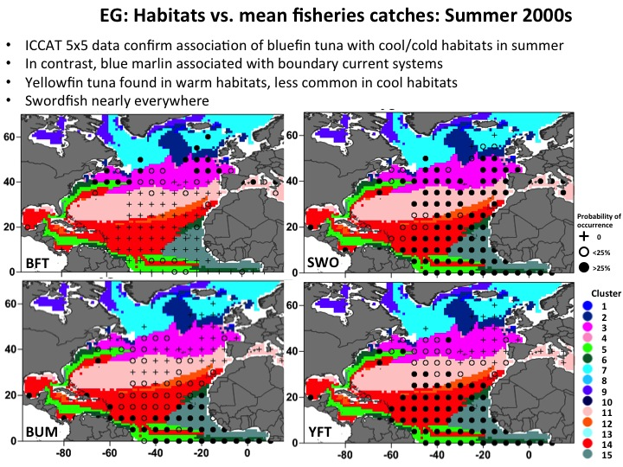

Slide 28
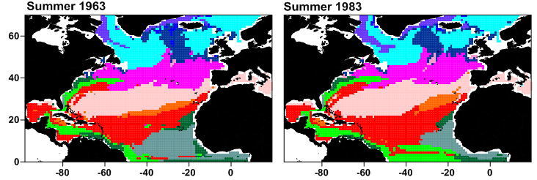
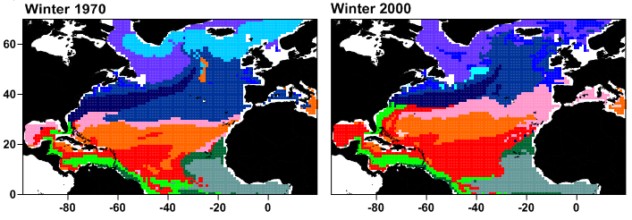
Dissimilar years
Picked two years with high dissimilarity from PCO ordination:
  Summer 1963 and 1983; Winter 1970 and 2000
During summer, 1963 has much higher extent of #15 (upwelling), less #14 (warm, low chlorophyll)
During winter, 1970 has more # 2 (cold), less #4 (warm, low chlorophyll)
Next step: what’s driving (or correlated with) this variability?
Cluster
1
2
3
4
5
6
7
8
9
10
11
12
13
14
15

Slide 29



Always Thinking About Transition & Outreach !
Our partners at NOAA are routinely using satellite data and habitat modeling for their research and management decisions.
Others in and outside of NOAA are starting to use this too.

Slide 30
Transition and Outreach
Expanded Our Research
International collaborations
  1° Mexico and Spain; 2° Japan
Found other spawning areas not previously reported
Use of genetics for egg and larvae ID
Evaluation of circulation models for climate work
Expanded to other resources (reef fish, tarpon, bonefish, coral)
Expanded to other ecosystem issues
  Issues related to larval survival & recruitment
    Food, growth and age issues -> revised growth curve
  Oil impacts (British Petroleum Deepwater Horizon)

Slide 31
Other Publications
Muhling, B.A., Lee, S-K, Lamkin, J.T. (2011) Predicting the effects of climate change on bluefin tuna (Thunnus thynnus) spawning habitat in the Gulf of Mexico. ICES Journal of Marine Science 68: 1051-1062.
Muhling, B.A., Roffer, M.A., Lamkin, J.T., Ingram, G.W. Jr., Upton, M.A., Gawlikowski, G., Muller-Karger, F., Habtes, S., Richards, W.J. (2012) Overlap between Atlantic blueﬁn tuna spawning grounds and observed Deepwater Horizon surface oil in the northern Gulf of Mexico. Marine Pollution Bulletin, doi:10.1016/j.marpolbul.2012.01.034.
Liu Y., S.-K. Lee, B. A. Muhling, J. T. Lamkin and D.B. Enfield, 2012: Significant reduction of the Loop Current in the 21st century and its impact on the Gulf of Mexico. J. Geophys. Res., 117, C05039, doi:10.1029/2011JC007555
Muhling, B.A., P. Reglero, L. Ciannelli, D. Alvarez-Berastegui, F. Alemany, J.T. Lamkin, and M. A. Roffer. 2013. A comparison between environmental characteristics of larval bluefin tuna (Thunnus thynnus) habitat in the Gulf of Mexico and western Mediterranean Sea. Marine Prog. Ser. 486:257-276.
Muller-Karger, F.; Roffer, M.; Walker, N.; Oliver, M.; Schofield, O.; Abbott, M.; Graber, H.; Leben, R.; Goni, G., 2013. "Satellite Remote Sensing in Support of an Integrated Ocean Observing System," Geoscience and Remote Sensing Magazine, IEEE , 1 (4):8-18, 2013 doi: 10.1109/MGRS.2013.2289656
Hooidonk, R.V., J.A. Maynard, Y. Liu, and S.K. Lee. 2015. Downscaled projections of Caribbean coral bleaching than can inform conservation planning. Global Change Biol. Doi: 10.1111/gcb.12901

Slide 32
Thanks to NASA & Woody for allowing me to be a 10 year member of the NASA Biodiversity and Ecosystem Forecasting Team as a PI on three major projects
Questions ?

